Slide 1

Designing Engaging In-Class Activities
Petra Bonfert-Taylor
12 January 2018
https://curatedcourses.org/
Notes:
Cover Page

Slide 2

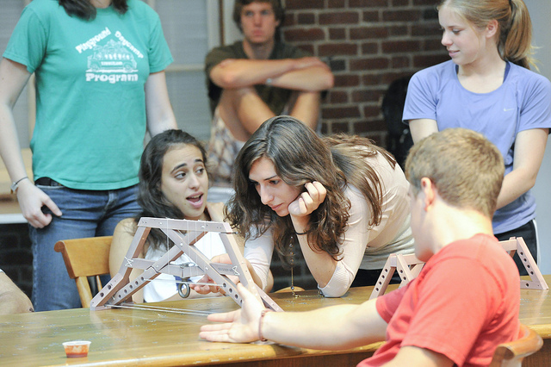

Active Learning
Rather than passively listening to information being transmitted: students learn through activities and/or discussions
Large body of scientific evidence asserts:
Retention improves significantly if learning is active.
Active learning leads to significantly lower failure rates in STEM classes.
https://curatedcourses.org/

Slide 3
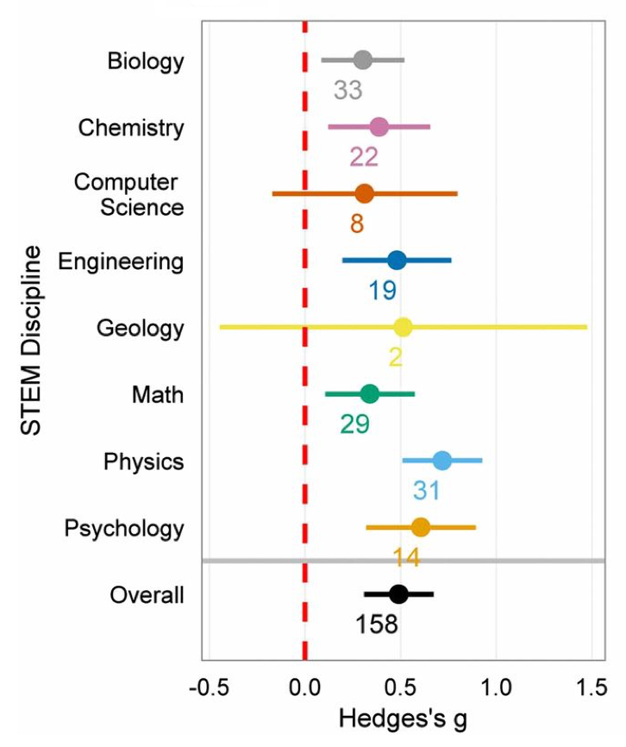
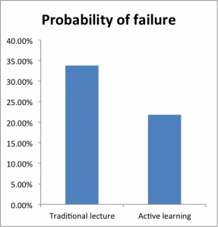
The Data on Active Learning
Freeman et al, Proceedings of the National Academy of Sciences, 2014:
Meta-analyzed 225 studies on STEM courses:
examination scores / failure rates
comparing traditional lecturing versus active learning
Effect size on examination scores, assessments, etc.
Probability of failure
https://curatedcourses.org/

Slide 4
Why You Should NOT REPEAT the Pre-Class Work
https://curatedcourses.org/

Slide 5
Why You Should NOT REPEAT the Pre-Class Work
Students gain first exposure prior to class.
Provide incentive for students to complete the pre-class work.
Assess student understanding (either prior to or at the beginning of class).
Use class time to focus on higher level cognitive activities
https://curatedcourses.org/

Slide 6
Some Active Learning Ideas
Think-Pair-Share Pose question to class, have students individually think of and write down answer, then form pairs, discuss responses, randomly call on a few students to share their answers.
Jigsaw Break class into four “expert groups”, have each expert group study different aspect of a problem; then assemble new groups of four students (one from each expert group), within each group have students teach their expertise to the others.
Classroom Response System Can be used for formative assessment, initiation of discussion, peer instruction, contingent teaching, etc. Many question banks available.
https://curatedcourses.org/

Slide 7
Some Active Learning Ideas, cont.
Concept Maps Have students create a map connecting the major topic of focus with what they consider its most important features, ideas and concepts that they have learned (in groups or as classroom discussion)
Thinking Aloud in Pairs
Students paired, given series of problems
Two roles (switch after each problem): Problem Solver and Listener
Problem solver talks through solution to problem.
Listener follows all steps, catches errors.
Listener may ask clarifying questions but not guide the problem solver to solution
Listener should not explicitly highlight specific error except comment that an error has been made.
Etc.
https://curatedcourses.org/

Slide 8
Making Groups Work
When the bread was finished, the tired little red hen asked her friends, "Who will help me eat the bread?”
"I will," barked the lazy dog. "I will," purred the sleepy cat. "I will," quacked the noisy yellow duck.
"No!" said the little red hen. "I will." And the little red hen ate the bread all by herself.
https://curatedcourses.org/

Slide 9
Making Groups Work
Create interdependence
Make projects sufficiently complex so tasks can’t just be divvied up
Assign roles
Create shared goals
Devote time specifically to teamwork skills
Team contracts, team assessments, process assessment
Conflict resolution skills
Build in individual accountability
Assess individual learning as well as group progress
Pay attention to group composition
Diversity (gender, prior knowledge, etc.)
Scheduling of meeting times
Interests
https://curatedcourses.org/

Slide 10
What Makes Engaging Problems?
https://curatedcourses.org/

Slide 11
What Makes Engaging Problems?
It’s useful to be perplexed!
Keep questions concise.
Use pictures to establish context.
Set a low bar to get started, a high bar to finish.
Minimize cognitive load (progressively reveal content).
Ask for guesses.
Make it social.
https://curatedcourses.org/

Slide 12
Variety Addresses Different Learning Styles
https://curatedcourses.org/

